Slide 1



Unupervised Learning
Determine ultimate uber positioning
Ferdinand Leube - Nat
JUL, 3rd | PARIS
DAFT MAY2022

Slide 2


Business case
Domain
Optimal Uber positioning based on previous requests grouped by day of the week and time of the day
Problem
Find clusters of incoming uber requests, in order to determine where an uber should position itself best being closest to the requests in the cluster/area he is in given the time and day

Slide 3
Plan
Review data
Check for necessity of data cleaning
Data preparation
Search for ultimate Model
Apply ultimate model
Create folium maps

Slide 4
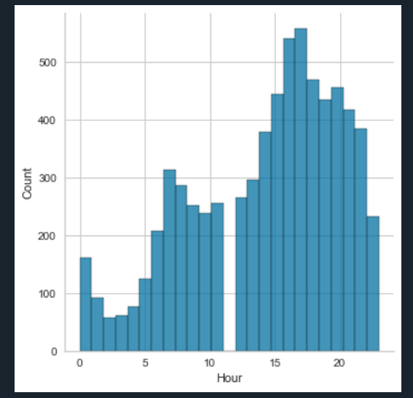
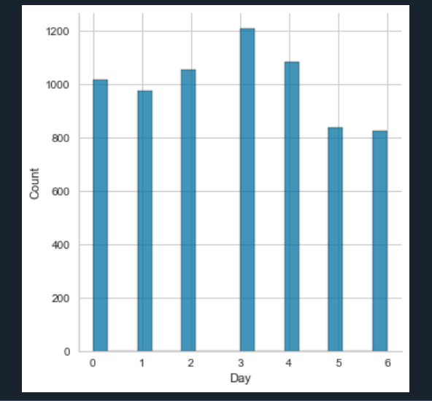
EDA and Data cleaning
The data cleaning and exploratory data analysis process:
Check for missing values
Check unique values of columns
Encode if necessary
Perform EDA

Slide 5
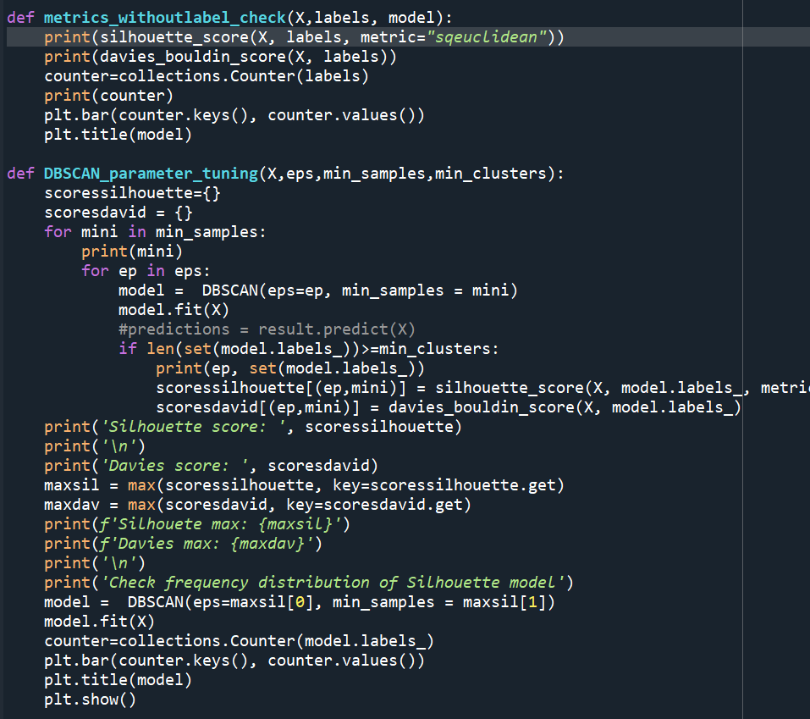
Data preparation for models and Model application
Due to computer limitations, started off by taking a sample of raw data to continue further process of model building
Created our x train set consisting of Lat and Lon coordinates
First Model :
Kmeans
- Used the Kelbow Visualizer metod to determine the best value for n_clusters
Applied the model and cheked the metrics as well as distribution of clusters with self made function
DBSCAN
Created our own function to perform hyper parameter tuning on eps and min samples values
Applied model and ran checks
AgglomerativeClustering
Again used Kelbow method
Performed checks with function

Slide 6
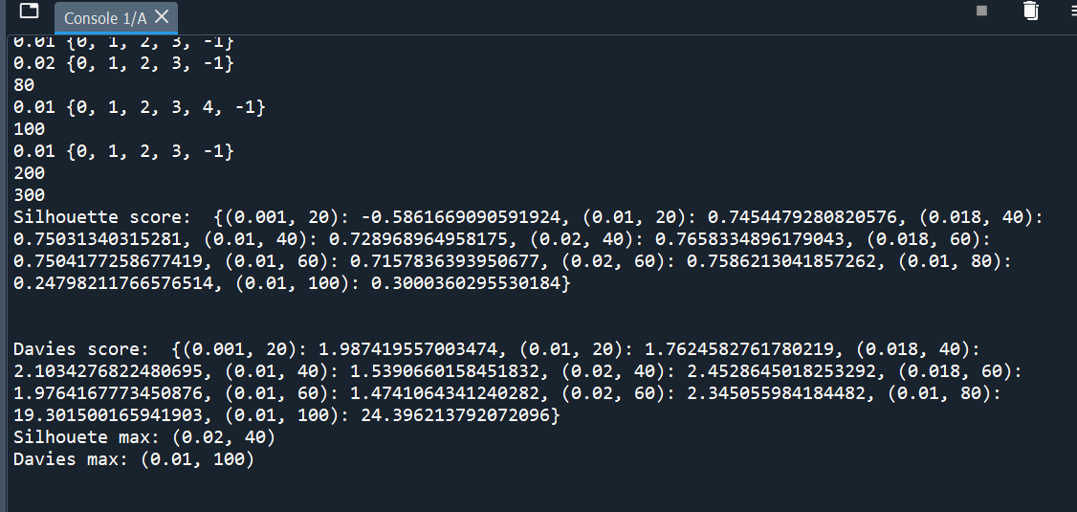
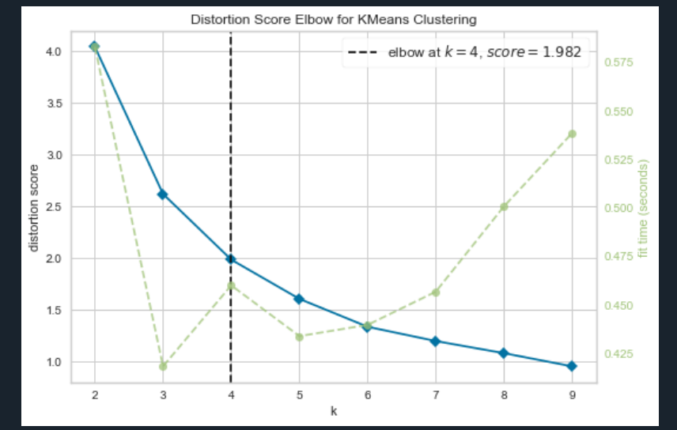
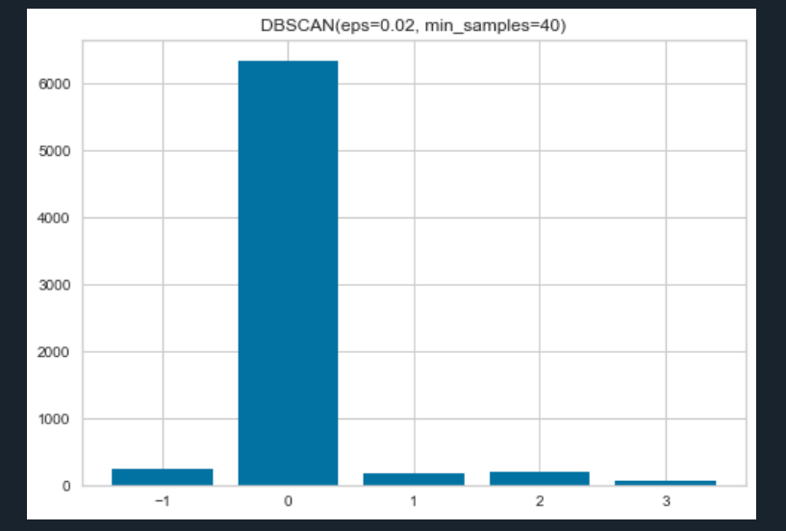
Results of checks and other visualizations
Anyone wants a function demo?

Slide 7
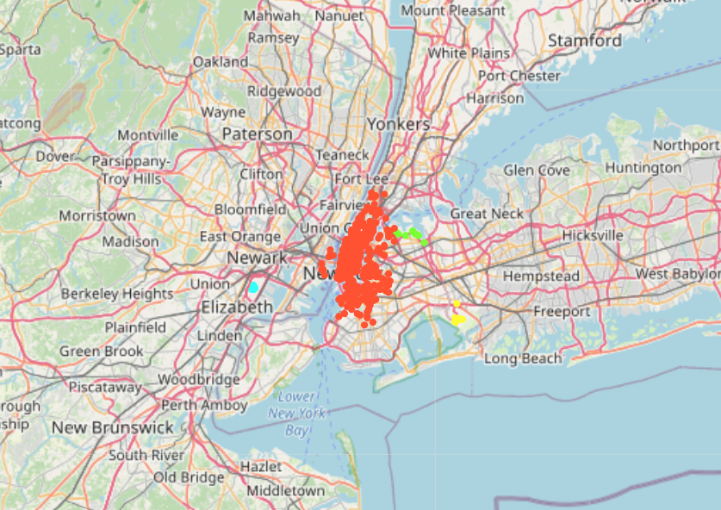



Map creation
DBSCAN → best model taking into account metrics and a realistic number of clusters
Continued creating a map using folium in jupyter notebook

Slide 8
Map Improvement
Gives us 4 very clearly separated areas, gives us some elpful information, no necessity of driving around outside these clusters
BUT!!
Still a very big cluster in the middle of the city, no real conclusion regarding business case, wants new York, especially centre to be divided in multiple areas to assign Ubers to certain areas and their centres in stead of cursing through city aimless
Selected all rows with cluster Manhattan
Performed another supervised learning model
Used KMEANS, trying multiple different number of clusters and checked metrics
Decided on what model to use
→ Especially based on equal frequency per clster to have good definable areas that drivers can be assigned to

Slide 9
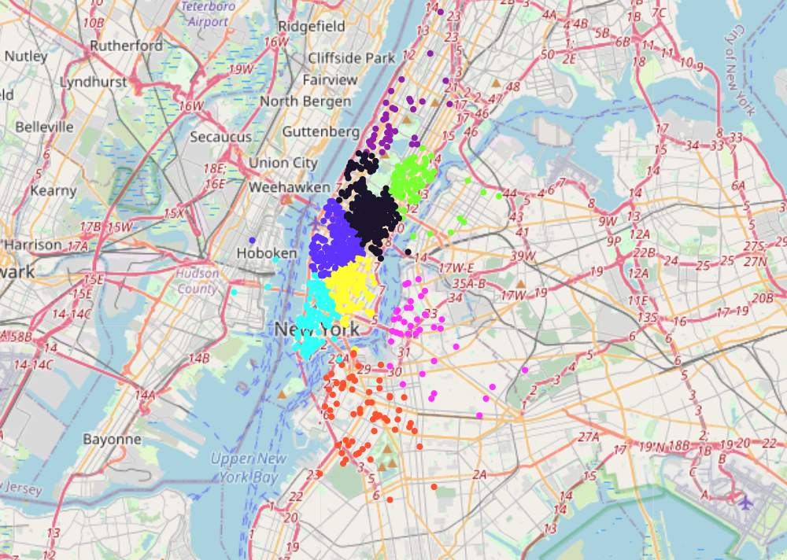
Map Improvement
After applying model → added new labels and mapped the city centre clusters
Nicely divided structured clusters → the results we want
Example map for cluster distribution on a Thursday
Wrote another function giving option to also view distribution by day time

Slide 10
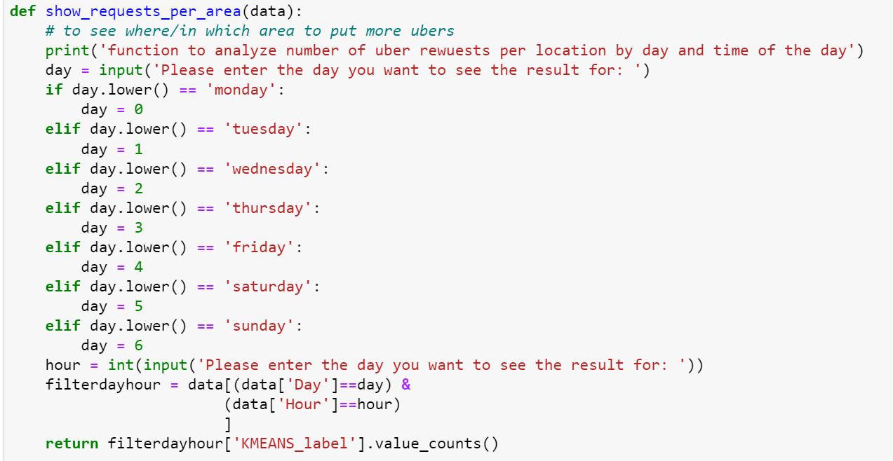
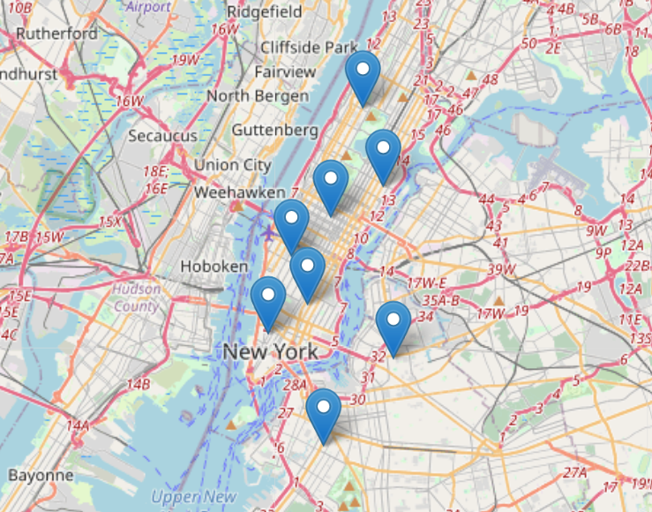
Further products for business case
Function giving user input option for day of week and time
Outputs number of requests per cluster
For company like e.g. uber good to know how many drivers to position where at what time and day
Mapping cluster centers → best location to be for uber drivers without clients, shortest distance to requests from cluster area

Slide 11
Unpervised Learning
Questions?
Ferdinand Leube - Nat
Merci Beaucoup

